Slide 1
Project Proposal
CSE-427 (Software Quality Assurance and Testing)

Slide 2
Group: 11
Team Members:
Mahmudul Hasan - 1521406042
Samsul Arefin Riffat - 1611274042

Slide 3
Question Analyzer
What is Question Analyzer?
Question Analyzer is an application for searching chapters from given questions. It takes input from the user and find out the chapter the question is asked from.

Slide 4
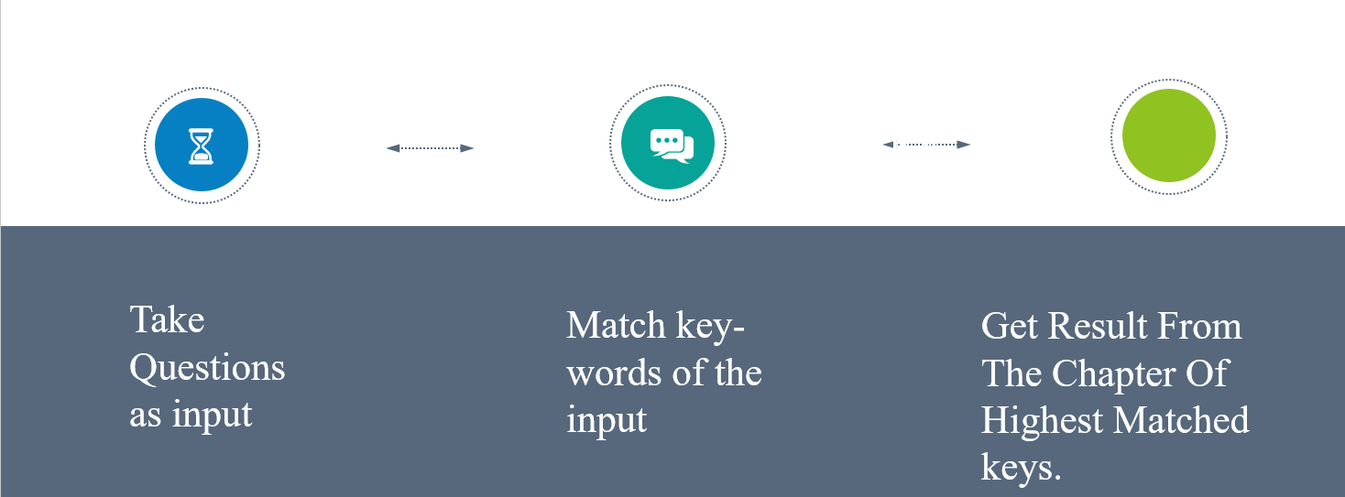
Process-Flow Diagram

Slide 5
Uses
Find out the chapter questions asked from as quick as possible.

Slide 6
Future Works
Gaining maximum output accuracy.
Adding more chapters and books.
Searching faster.

Slide 7
Conclusion
The app will be able to eliminate cumbersome and monotonous to search a particular question manually.

Slide 8
Thank You

